Slide 1

Using AI to discover and present
local NHS and healthcare services
Peter Thompson
Head of Software and Cloud Architecture
NHS South Yorkshire

Slide 2
South Yorkshire
Growth Accelerator
South Yorkshire was identified as one of five pilot programmes across England to support accelerated return to work programmes.
SY ICB was tasked with identifying and support people in South Yorkshire who are at risk of going on long-term sick due to physical and mental health issues. The initiative is designed to refer those on the programme
to relevant and commissioned local services who could
improve their likelihood of returning to work.
Notes:
https://www.england.nhs.uk/2024/12/world-leading-nhs-trial-to-boost-health-and-support-people-in-work/
https://southyorkshire.icb.nhs.uk/news/south-yorkshire-launches-innovative-health-and-work-programme-help-people-stay-well-learn-and-work
https://www.gov.uk/government/news/south-yorkshire-kicks-off-125-million-plans-to-get-britain-back-to-health-and-work

Slide 3
Purpose
A digital service to enable
case worker staff to discover and recommended local services in
South Yorkshire to patients on the
Growth Accelerator programme.

Slide 4
5 Goals & Principles
Utilise existing directories & knowledge
Utilise proven AI models, with customisation, to understand intent and deliver better results
Maintain data ownership and the value from it
Design for change and avoid lock-in
Enable scaling and sharing
Notes:
Utilise and gain value from existing local directories, rather than building a new one
Enhances the interaction with existing datasets, leveraging value from off-the-shelf AI models which can be used at cost
It is important that any value built from this project is owned within the NHS rather than an external supplier
This is a new solution so the architecture needs to be flexible, with change expected
Easy and low-cost to scale, so that NHS orgs and patients can benefit from it without cost/tech hurdles

Slide 5
Solution Components
Familiar chat interface
AI LLM Interpretation Layer
Service Index
Automated Service Updates

Slide 6
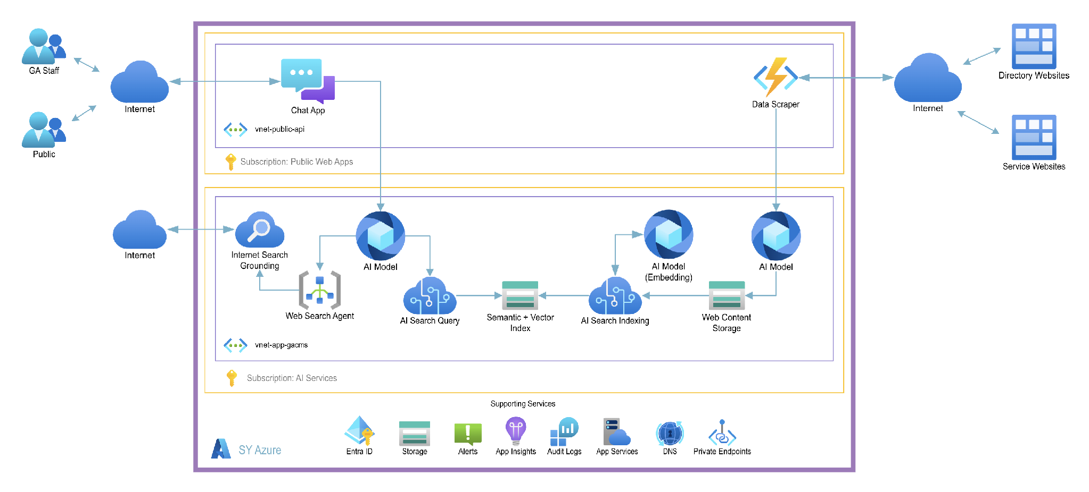
Software Development
Agile approach: Microsoft Azure Platform,
1 Architect, 1 Developer
Notes:
Developed internally
Using our Microsoft Azure platform – which is where our data centre is
Architect – Me, Contracted developer
From a technical perspective:
We have a Microsoft Azure tenancy where this is built (alongside our other apps and services)
We use Azure to host and provide the compute for AI Models – which means we can choose from a wide range
So far, we’ve used OpenAI models – gtp-4o-mini and text-embedding-3 – cost/performance decision to allow scaling
We’ve utilise Azure AI Search with vectorisation
To run the front-end app and backend services we’ve used App Service and Function Apps
Only the front-end app endpoints are network accessible, with the other services accessible via specifically configured private endpoints
Any questions about the architecture or our decisions

Slide 7
Frontend
Staff search on condition or need
AI interprets requests and formats results
Results retrieved from service index
Training Data and Online Sources
Notes:
RAG (Retrieval augmented generation)
Used a mix of search results and AI generation.

Slide 8
Backend
Scheduled Updates
Scrape and Spider sources list
AI scraping & summaries
JSON Service Summaries
Semantic and Vectorised Indexing
OpenAI Text Embedding
Online Sources
Notes:
List managed in a SharePoint List
Spider and scrape

Slide 9
Agentic Integration
Users interact with AI Chat Tool in NHS App
National AI LLM provides general advice
Advice and guidance from NHS knowledge base
Results from local service directories
MCP Server
Notes:
Gives a national AI agent, local knowledge - Utilise the ability of AI Agents to talk to other AI agents (MCP architecture) to provide locally relevant information to patients using a national tool (NHS App)
Provides higher likelihood that voluntary and community services will be discovered and used by patients, reducing demand on centrally run NHS services.
Devolves ownership and workload for maintaining up-to-date service information down to local level – to the service themselves.
I understand you’ve been looking at Agentic approaches?

Slide 10
AI for Digital Transformation
Learning points so far:
AI technologies are accessible
Platforms like Microsoft Azure make pilots low cost
NHS organisations can learn on the journey
Staff and patients can benefit from simple use cases
Notes:
Some of the opportunities for Ai to be used today

Slide 11
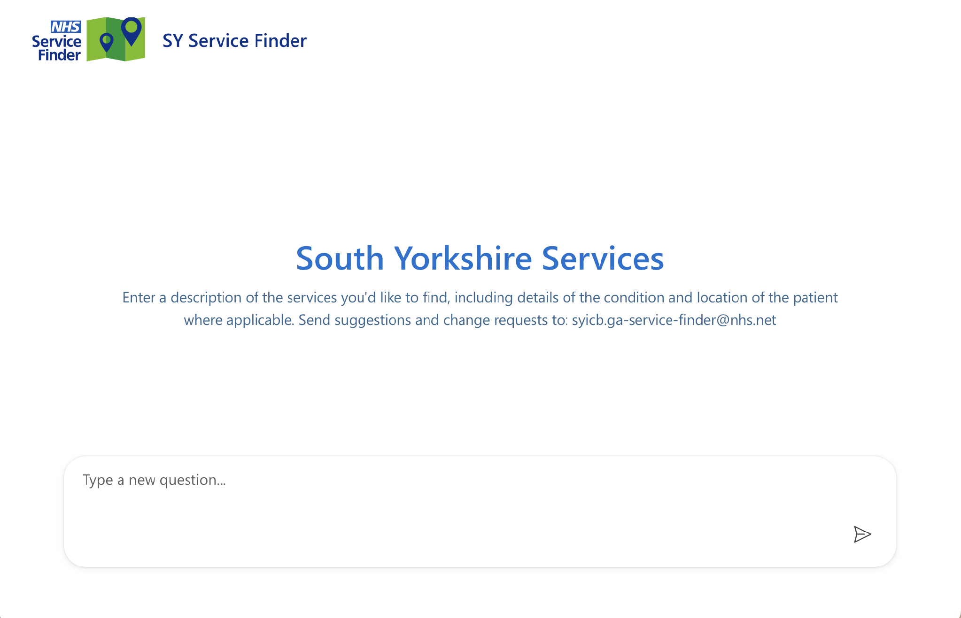
Notes:
Demo
https://service-finder.southyorkshire.nhs.uk/
mental health and wellbeing support services, near Sheffield, for adults aged 18-65
(commissioned OFF)
Map Click: Good Work
Tell me more about Together for Mental Wellbeing
Sources
Meklink
NHS App

Slide 12
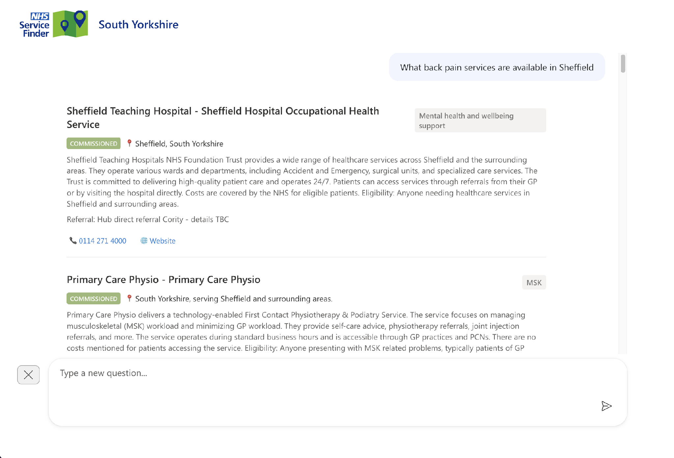
Shows results prioritised by multiple factors
Can be copied and share with patients via email or directly
Internet-sourced results are also included to provide comprehensive and up-to-date results
Information is constantly and automatically updated from source websites

Slide 13
Services can be prioritised and flagged
AI Models provide easy-to-read service summaries, automatically updated from source websites
Growth hub staff can add manual information (like Referral details) for specific entries
Contact details are automatically discovered and formatted by AI scraping agents

Slide 14
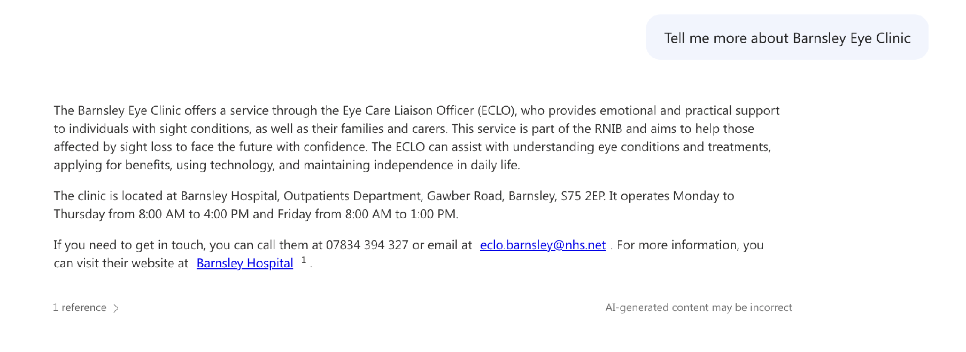
Ask follow-up questions
“Is the service free”
“Tell me more about…”
“Which bus goes there”
“Is this service suitable for…”
Notes:
Utilise general LLM capabilities to interrogate the service results with general knowledge and internet searches, to ask (for example):
Tell me more about…
Is this service suitable for…
What public transport is available to get there
How far is it from…
Is the service free

